Slide 1
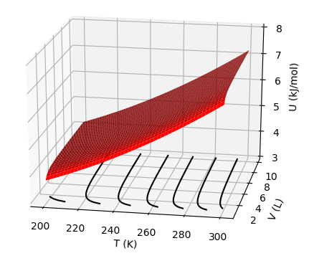
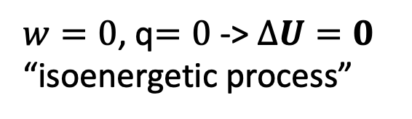
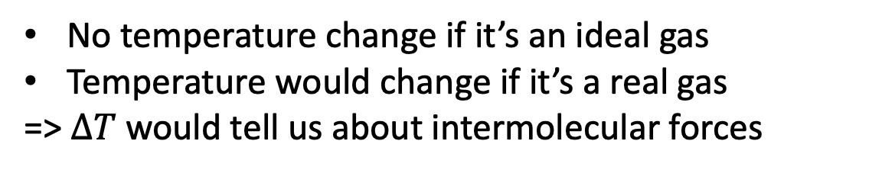
$w=0$, q$=0$ -> $∆U=0$
“isoenergetic process”
Joule experiment is adiabatic, and no work is done
No temperature change if it’s an ideal gas
Temperature would change if it’s a real gas
=> $∆T$ would tell us about intermolecular forces

Slide 2
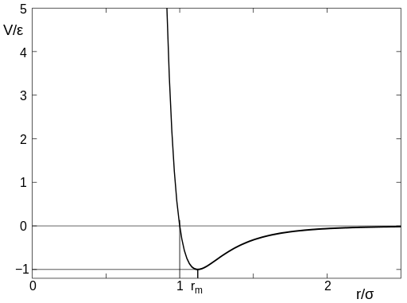
$w=0$, q$=0$ -> $∆U=0$
“isoenergetic process”
Joule experiment is adiabatic, and no work is done
Climbing uphill in potential energy would cause molecules to slow down, hence lower temperature
d

Slide 3
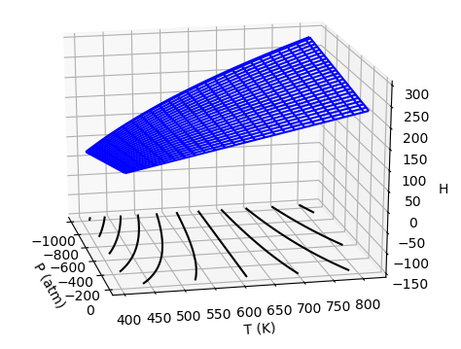
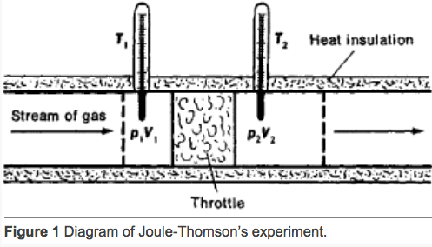
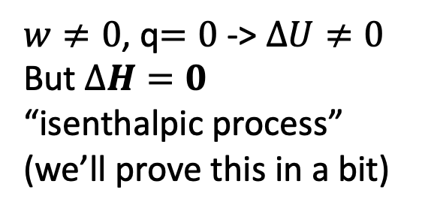
Joule-Thomson experiment is also adiabatic, but work is done
$w≠0$, q$=0$ -> $∆U≠0$
But $∆H=0$
“isenthalpic process”
(we’ll prove this in a bit)
No temperature change if it’s an ideal gas
Temperature would change if it’s a real gas
=> $∆T$ would tell us about intermolecular forces
https://encyclopedia2.thefreedictionary.com/Joule-Thomson+Effect

Slide 4

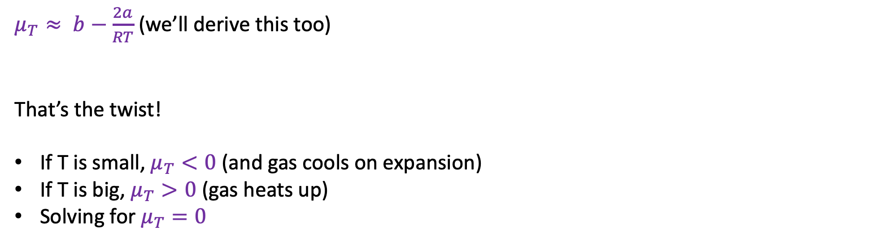
Joule-Thomson: Thermodynamic analysis
$μ_{T}≈ b−\frac{2a}{RT}$ (we’ll derive this too)
That’s the twist!
If T is small, $μ_{T}<0$ (and gas cools on expansion)
If T is big, $μ_{T}>0$ (gas heats up)
Solving for $μ_{T}=0$
$$T_{inversion}=…$$

Slide 5

Joule-Thomson: Thermodynamic analysis
$μ_{T}≈ b−\frac{2a}{RT}$ (we’ll derive this too)
That’s the twist!
If T is small, $μ_{T}<0$ (and gas cools on expansion)
If T is big, $μ_{T}>0$ (gas heats up)
Solving for $μ_{T}=0$
$$T_{inversion}=\frac{2a}{bR}$$

Slide 6
Joule-Thomson: Thermodynamic analysis
$∆H=∆U+∆\left(PV\right)=$

Slide 7
Joule-Thomson: Thermodynamic analysis
$∆H=∆U+∆\left(PV\right)=q+w+P_{2}V_{2}−P_{1}V_{1}$ ... Definitions

Slide 8
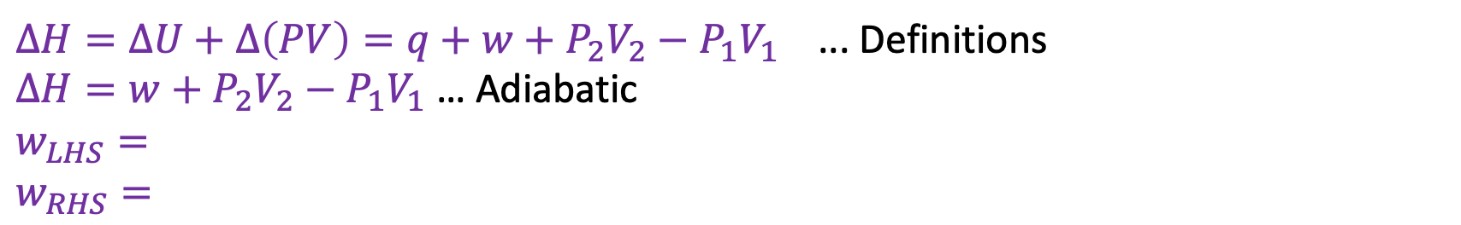
Joule-Thomson: Thermodynamic analysis
$∆H=∆U+∆\left(PV\right)=q+w+P_{2}V_{2}−P_{1}V_{1}$ ... Definitions
$∆H=w+P_{2}V_{2}−P_{1}V_{1}$ … Adiabatic
$w_{LHS}=$
$w_{RHS}=$

Slide 9
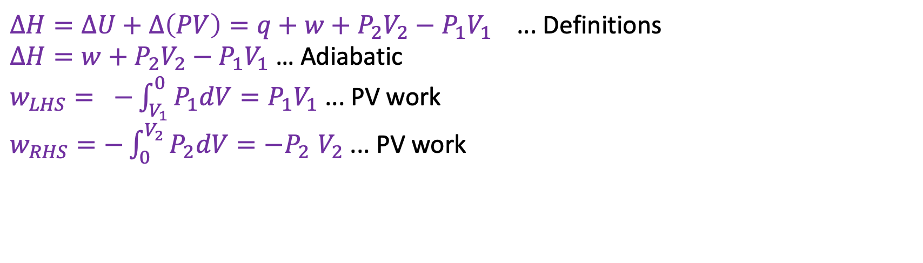
Joule-Thomson: Thermodynamic analysis
$∆H=∆U+∆\left(PV\right)=q+w+P_{2}V_{2}−P_{1}V_{1}$ ... Definitions
$∆H=w+P_{2}V_{2}−P_{1}V_{1}$ … Adiabatic
$w_{LHS}= −\int_{V_{1}}^{0}{P_{1}dV}=P_{1}V_{1}$ ... PV work
$w_{RHS}=−\int_{0}^{V_{2}}{P_{2}dV{=−P}_{2}V_{2}}$ ... PV work

Slide 10
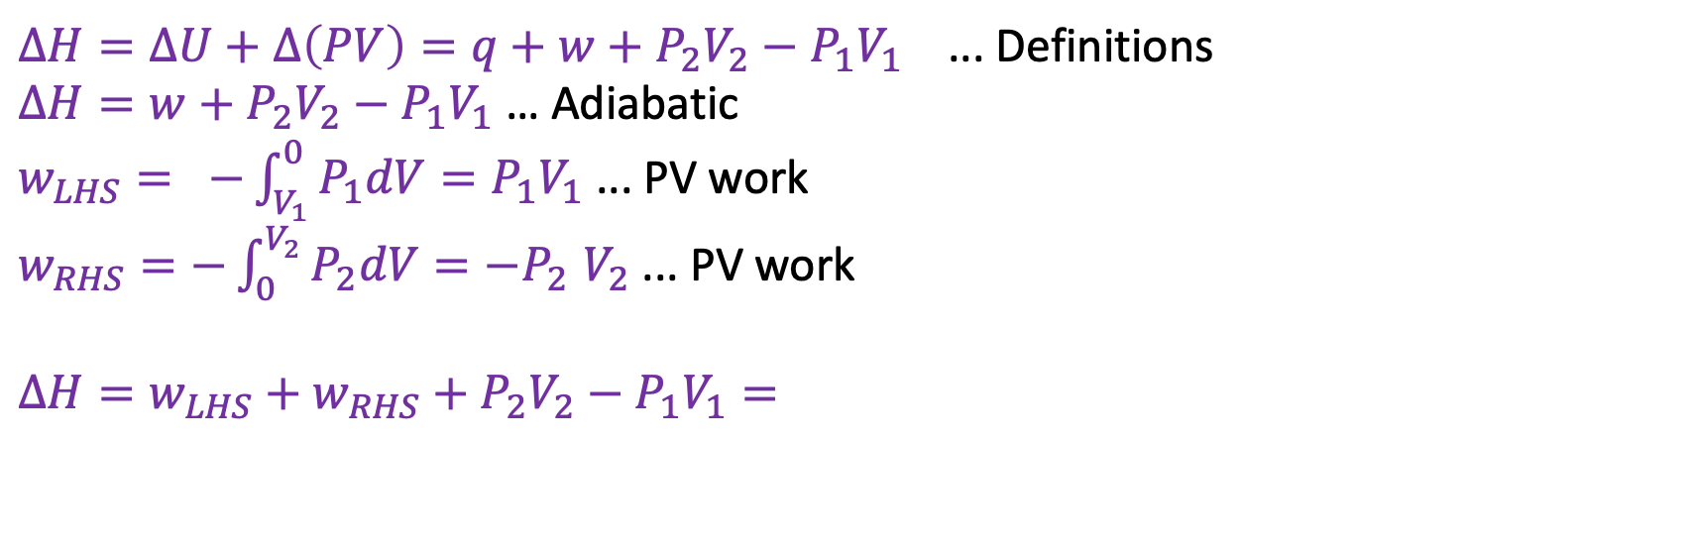
Joule-Thomson: Thermodynamic analysis
$∆H=∆U+∆\left(PV\right)=q+w+P_{2}V_{2}−P_{1}V_{1}$ ... Definitions
$∆H=w+P_{2}V_{2}−P_{1}V_{1}$ … Adiabatic
$w_{LHS}= −\int_{V_{1}}^{0}{P_{1}dV}=P_{1}V_{1}$ ... PV work
$w_{RHS}=−\int_{0}^{V_{2}}{P_{2}dV{=−P}_{2}V_{2}}$ ... PV work
$∆H=w_{LHS}+w_{RHS}+P_{2}V_{2}−P_{1}V_{1}=$

Slide 11
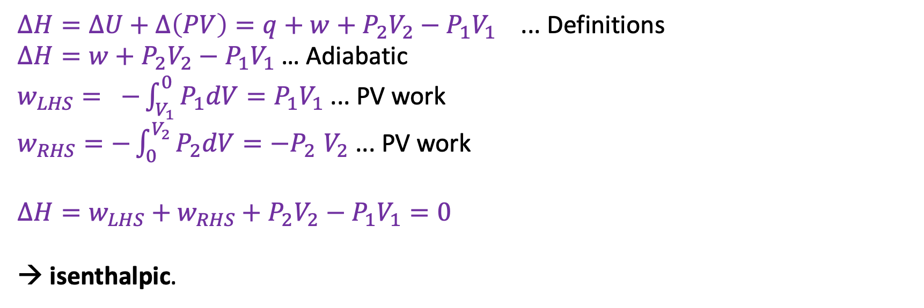
Joule-Thomson: Thermodynamic analysis
$∆H=∆U+∆\left(PV\right)=q+w+P_{2}V_{2}−P_{1}V_{1}$ ... Definitions
$∆H=w+P_{2}V_{2}−P_{1}V_{1}$ … Adiabatic
$w_{LHS}= −\int_{V_{1}}^{0}{P_{1}dV}=P_{1}V_{1}$ ... PV work
$w_{RHS}=−\int_{0}^{V_{2}}{P_{2}dV{=−P}_{2}V_{2}}$ ... PV work
$∆H=w_{LHS}+w_{RHS}+P_{2}V_{2}−P_{1}V_{1}=0$
→ isenthalpic.

Slide 12
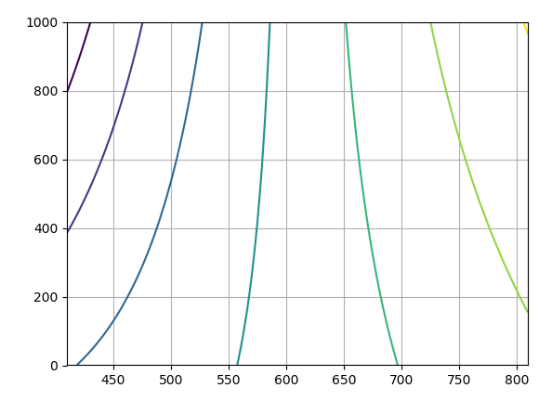
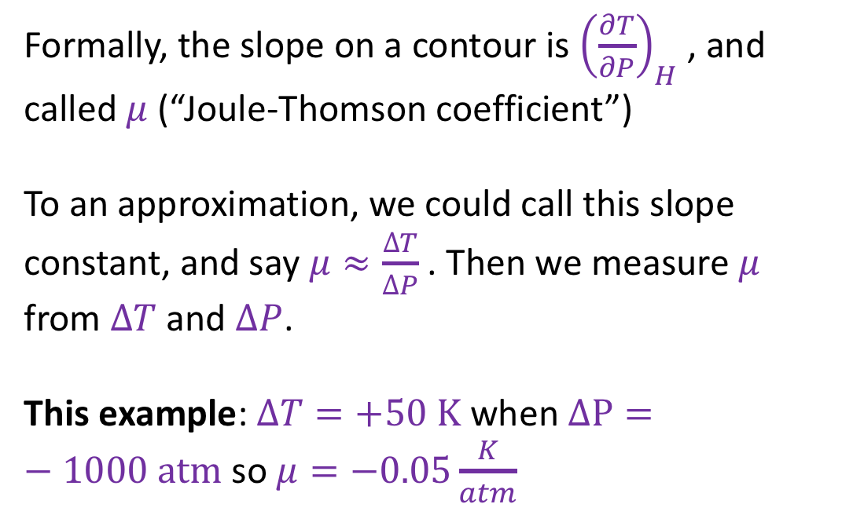
Joule-Thomson: Application
Formally, the slope on a contour is ${\left(\frac{∂T}{∂P}\right)}_{H}$ , and called $μ$ (“Joule-Thomson coefficient”)
To an approximation, we could call this slope constant, and say $μ≈\frac{∆T}{∆P}$ . Then we measure $μ$ from $∆T$ and $∆P$.
This example: $∆T=+50 K$ when $∆P=−1000 atm$ so $μ=−0.05\frac{K}{atm}$
P (atm)
T (K)

Slide 13
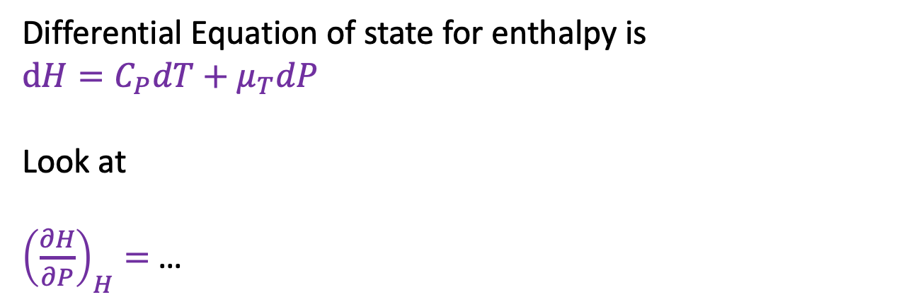
How to get $μ_{T}$ from $μ$?
Differential Equation of state for enthalpy is
$dH=C_{P}dT+$ $μ_{T}dP$
Look at
${\left(\frac{∂H}{∂P}\right)}_{H}=$ …
P
T

Slide 14
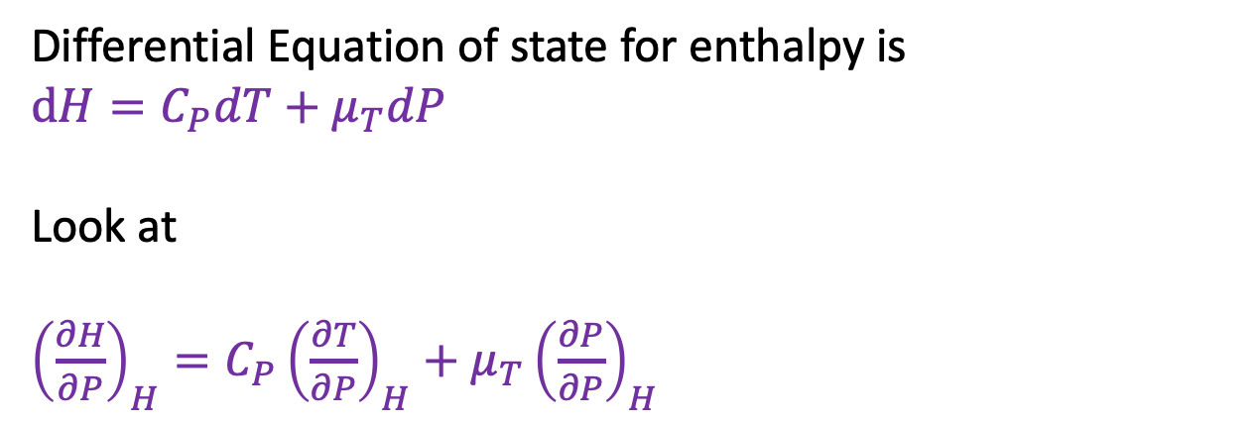
How to get $μ_{T}$ from $μ$?
Differential Equation of state for enthalpy is
$dH=C_{P}dT+$ $μ_{T}dP$
Look at
${\left(\frac{∂H}{∂P}\right)}_{H}=C_{P}{\left(\frac{∂T}{∂P}\right)}_{H}+μ_{T}{\left(\frac{∂P}{∂P}\right)}_{H}$
P
T

Slide 15

How to get $μ_{T}$ from $μ$?
Differential Equation of state for enthalpy is
$dH=C_{P}dT+$ $μ_{T}dP$
Look at
${\left(\frac{∂H}{∂P}\right)}_{H}=C_{P}{\left(\frac{∂T}{∂P}\right)}_{H}+μ_{T}{\left(\frac{∂P}{∂P}\right)}_{H}$
P
T
0
$$μ$$
1

Slide 16
How to get $μ_{T}$ from $μ$?
Differential Equation of state for enthalpy is
$dH=C_{P}dT+$ $μ_{T}dP$
Look at
${\left(\frac{∂H}{∂P}\right)}_{H}=C_{P}{\left(\frac{∂T}{∂P}\right)}_{H}+μ_{T}{\left(\frac{∂P}{∂P}\right)}_{H}$
P
T
0
$$μ$$
1
$$μ_{T}=−C_{P}μ$$

Slide 17

What we learned …
Architecture of adiabatic Joule-Thomson and Joule experiments
Why the adiabatic Joule-Thomson experiment is isenthalpic
How to use isenthalps and slopes of H(T,P) to compute $μ$
Derivation of $μ_{T}=−C_{P}μ$ and $T_{inversion}=\frac{2a}{bR}$

